Slide 1

Philadelphia Sentencing Prediction
With Ensemble Learning and Deep Learning

Slide 2
OUR TEAM
Shutian Ma
Rishabh Sharma
Divyanshu Kumar
bm3336@drexel.edu
rs3738@drexel.edu
dk984@drexel.edu

Slide 3
01
Introduction of the project

Slide 4
INTRODUCTION
The goal of this study is to develop a system for predicting the kind of sentencing from the provided docket data. While most studies solely focus on the docket description, this study along with the description also tries to concentrate on additional demographic parameters such as race, sex, judges, court name, court type, and title of the disposing authority in addition to the docket description. This study is based on the docket data collected for the cases in the Philadelphia Court of Common Pleas.

Slide 5
About this project
In the area of law and justice, sentencing prediction is a crucial instrument
The purpose of the project is to predict judicial sentencing based on docket data with machine learning and deep learning methods
Source of data: rladiesPHL/2021_datathon: Public repository for the R-Ladies Philly & JAT datathon on "Exploring judicial patterns in Philadelphia courts" (github.com)
Notes:
We met this data set on a hackathon we attended during this term. Since this year's topic is a little bit different from prediction, we decided to explore further more on the data set by ourselves

Slide 6
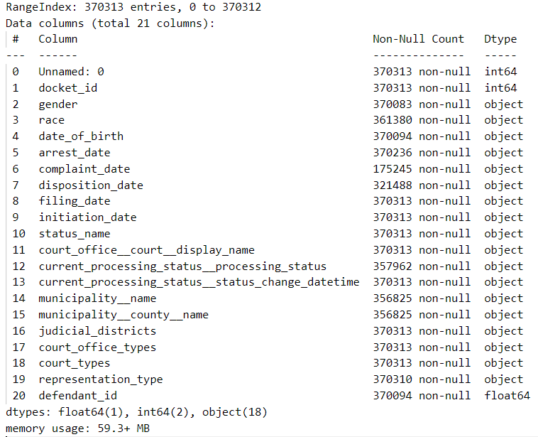
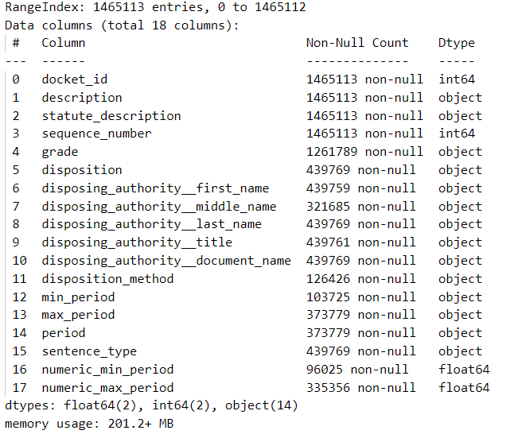
Data Source
The 2 Datasets used are defendant docket details and offense disposition
Defendant docket details contains attributes like race, age, sex, court types and other attributes
The offense disposition data contains attributes like docket description, grade, minimum sentence period, maximum sentence period and sentence type of the crime.
The following two tables are to be merged on the key - docket ID.
docket details
offense disposition

Slide 7
02
Data Overview

Slide 8
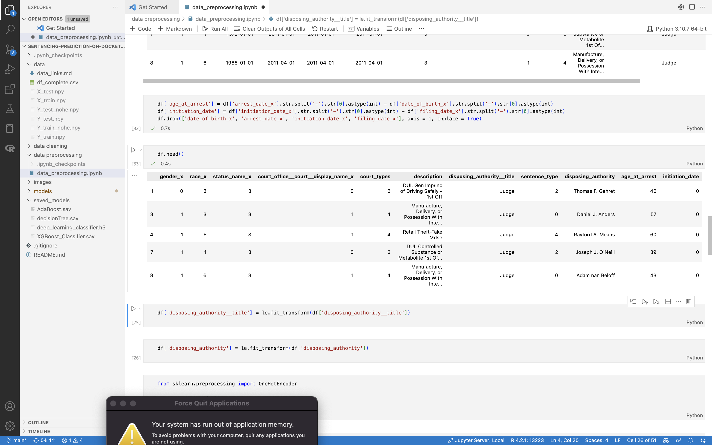
DATA OVERVIEW
After Cleaning and label encoding some of the categorical variables, The data set looks like
Notes:
Categorical: 6
Numeric: 2
Text: 2

Slide 9

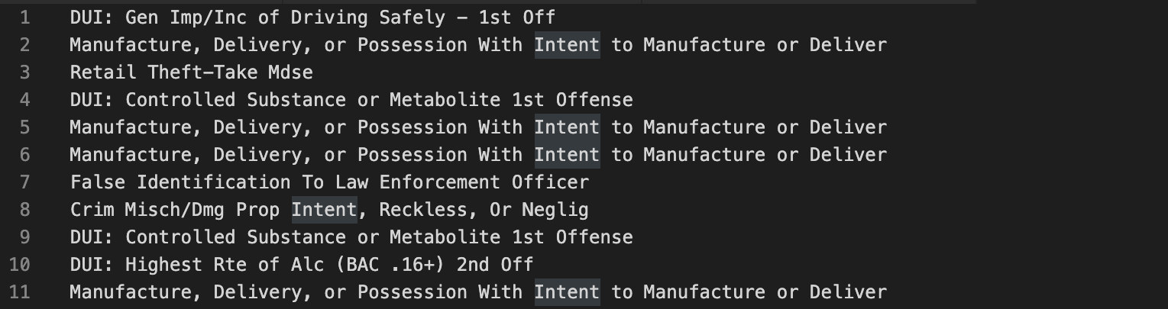
Describing Data
The available independent attributes are defendant docket details, offense disposition, bails, and many more. For this project, we have chosen the most pertinent datasets, that is, defendant docket details and offense disposition. These datasets also contain the description data for the various dockets.

Slide 10
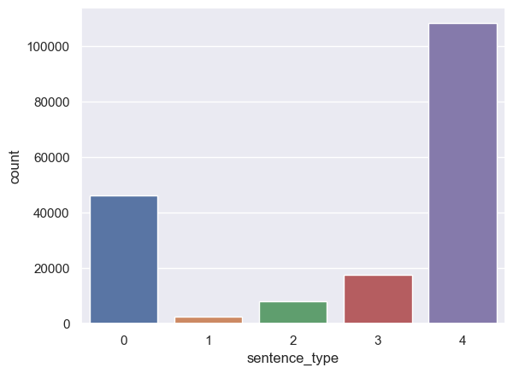
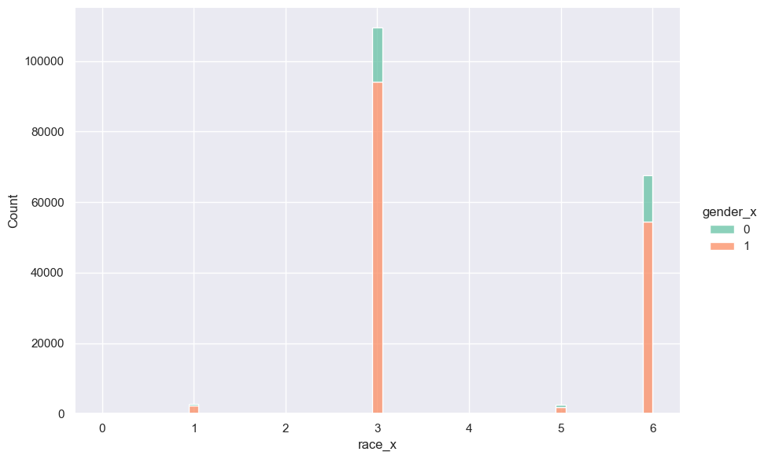
Data overview
Unbalanced dataset

Slide 11
03
Preprocessing Methods

Slide 12




Data preprocessing
STEP 01
STEP 02
STEP 03
STEP 04
Deal with text data
Merge multiple data frames into one
Fill out empty columns with proper values and SMOTE
Process categorical data using label encoding and one-hot encoding

Slide 13
04
Models
Decision Tree
Deep learning-based classifier
AdaBoost Classifier
XG Boost Classifier
Random Forest Classifier

Slide 14
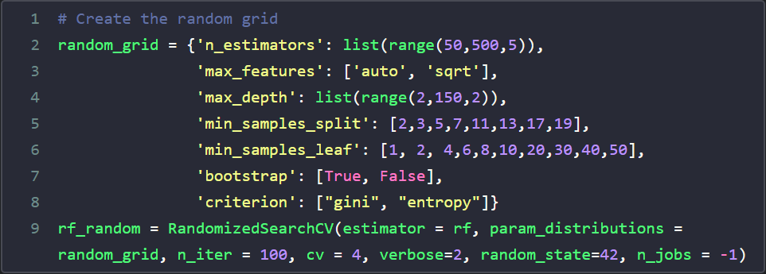
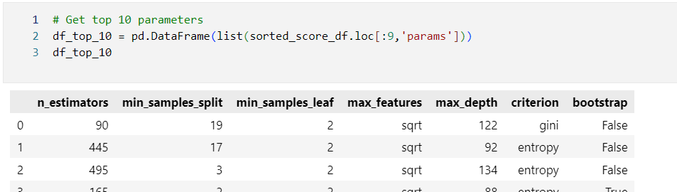
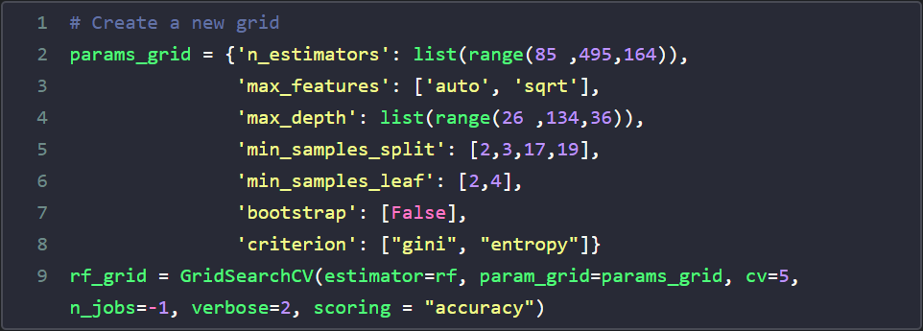
Hyper parameter tuning
Use random grid search for great range of parameters
Pick top 10 parameters sets
Build a new more detailed grid search based on these parameters
Notes:
Also other method,
We applied gradient descendent on XGBoost classifier
All models' accuracy improved about 2~3% in average

Slide 15
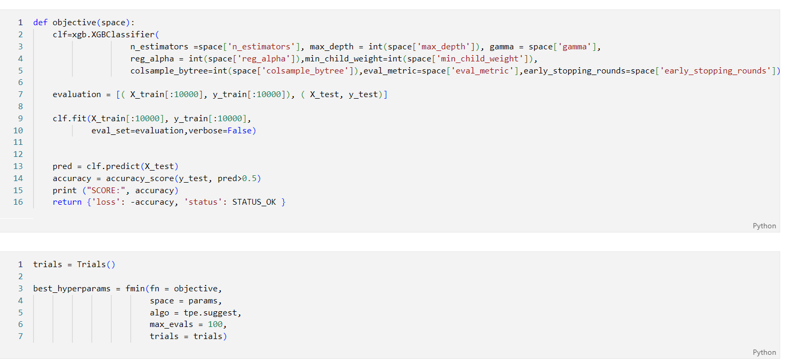
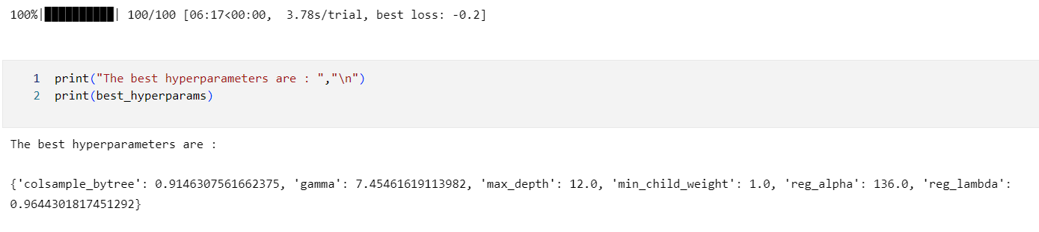
Hyper parameter tuning
Notes:
Also other method,
We applied gradient descendent on XGBoost classifier
All models' accuracy improved about 2~3% in average

Slide 16
Result parameter explanation
Scores:
Accuracy
Precision
Recall
F1
Classification Labels
Label | Sentence type
0 | Confinement
1 | IPP
2 | Merged
3 | No Further Penalty
4 | Probation

Slide 17
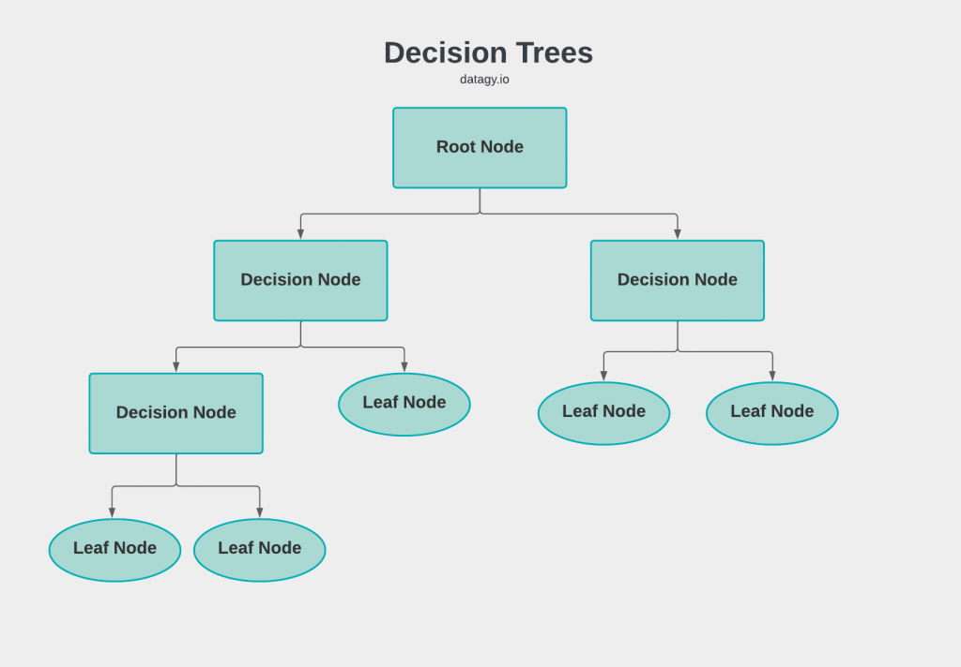
Decision Tree Classifier
Decision Tree is a Supervised Machine Learning Algorithm that uses a set of rules to make decisions, similarly to how humans make decisions. It uses the concept of gini index to make a split for decision.

Slide 18
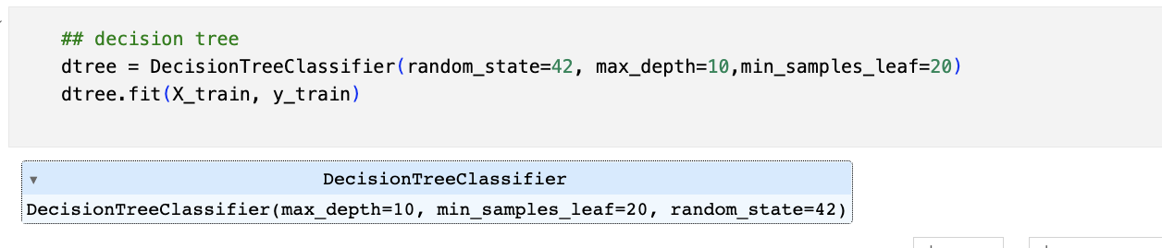
Decision Tree Classifier

Slide 19
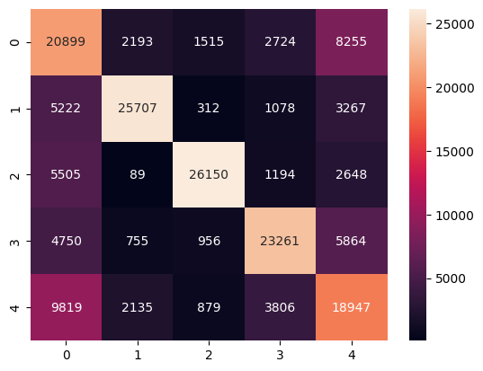
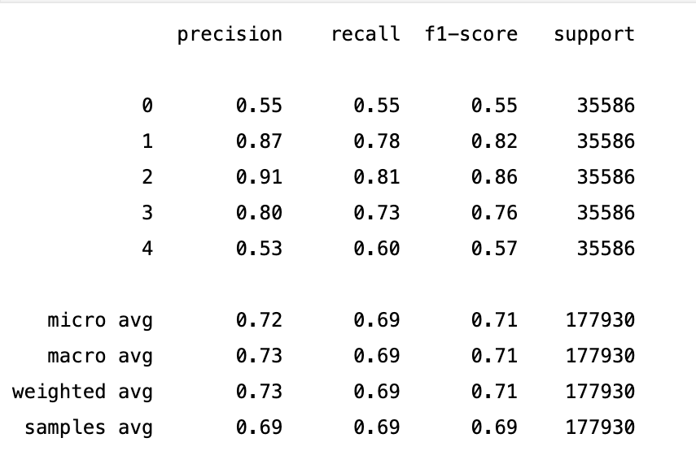
Decision Tree Classifier Results

Slide 20
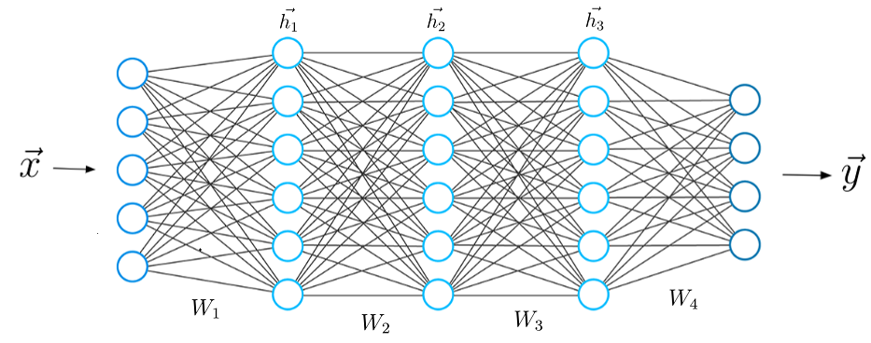
Deep Learning Classifier
Deep learning can be defined as the method of machine learning and artificial intelligence that is intended to copy humans and their actions based on certain human brain functions to make effective decisions. It is a very important data science element that channels its modeling based on data-driven techniques under predictive modeling and statistics.

Slide 21
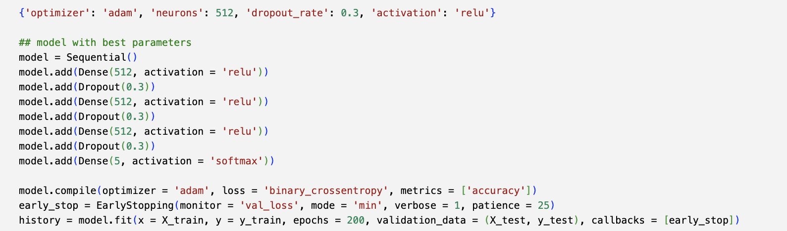
Deep Learning Classifier

Slide 22
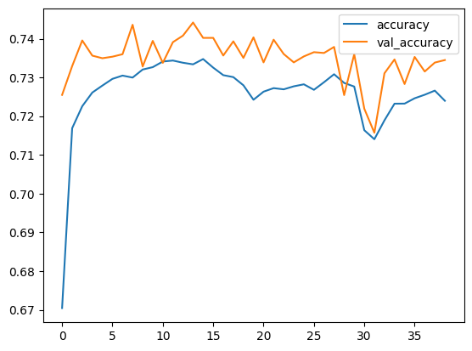
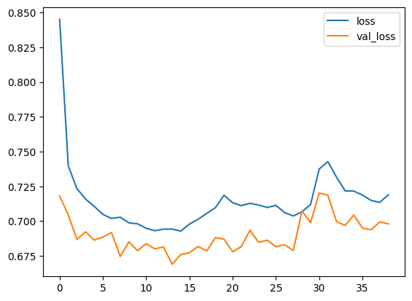
Deep Learning Classifier Results

Slide 23
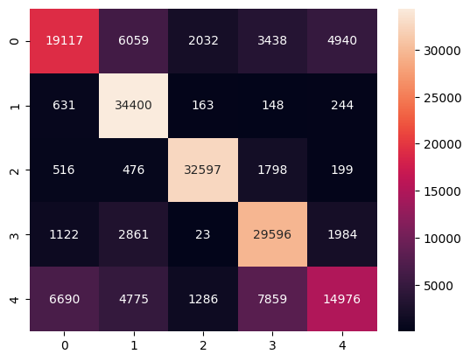
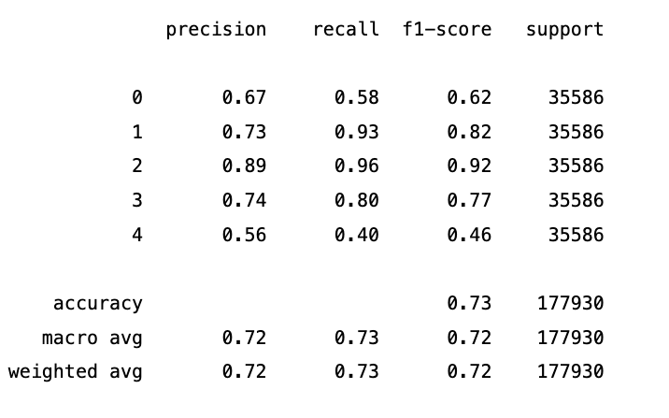
Deep Learning Classifier Results

Slide 24
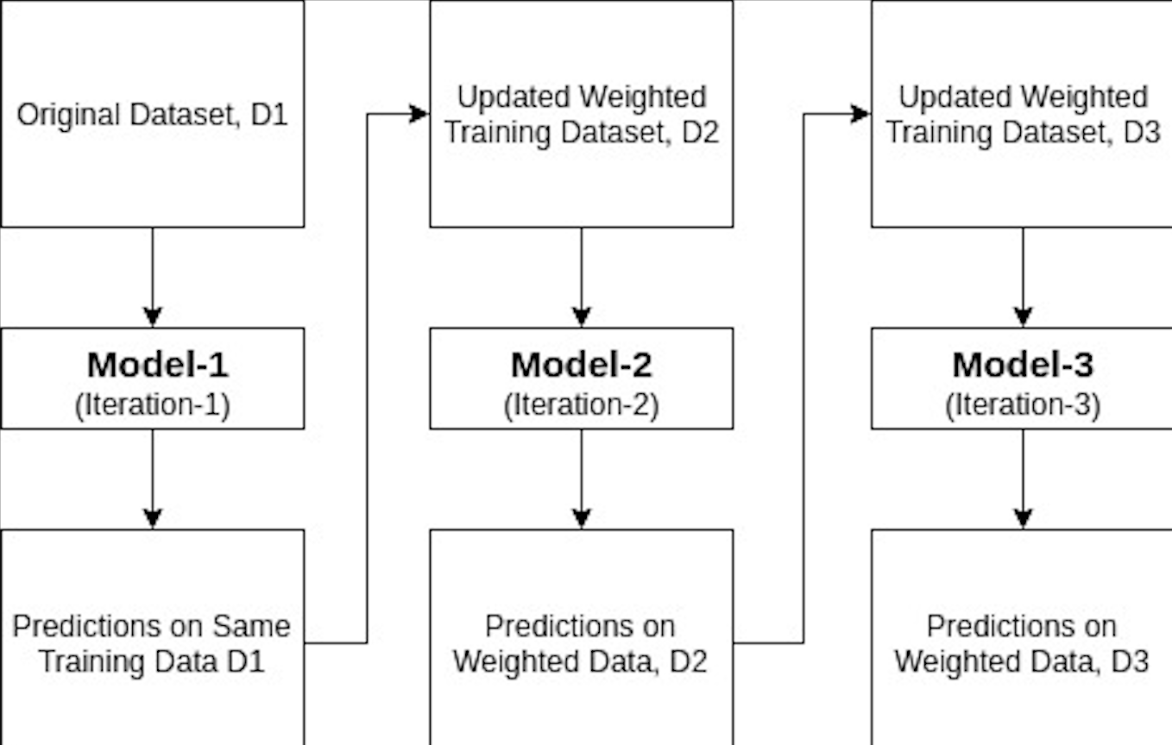
AdaBoost Classifier
AdaBoost or Adaptive Boosting is one of the ensemble boosting classifier that builds a strong classifier by combining multiple poorly performing classifiers so that you will get high accuracy strong classifier
The basic concept behind Adaboost is to set the weights of classifiers and training the data sample in each iteration such that it ensures the accurate predictions of unusual observations.

Slide 25
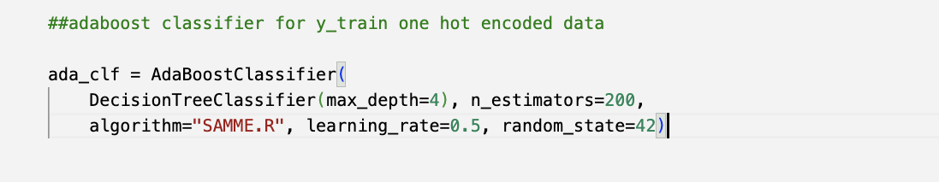
AdaBoost Classifier

Slide 26
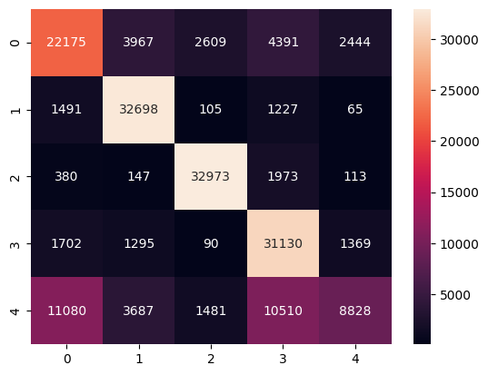
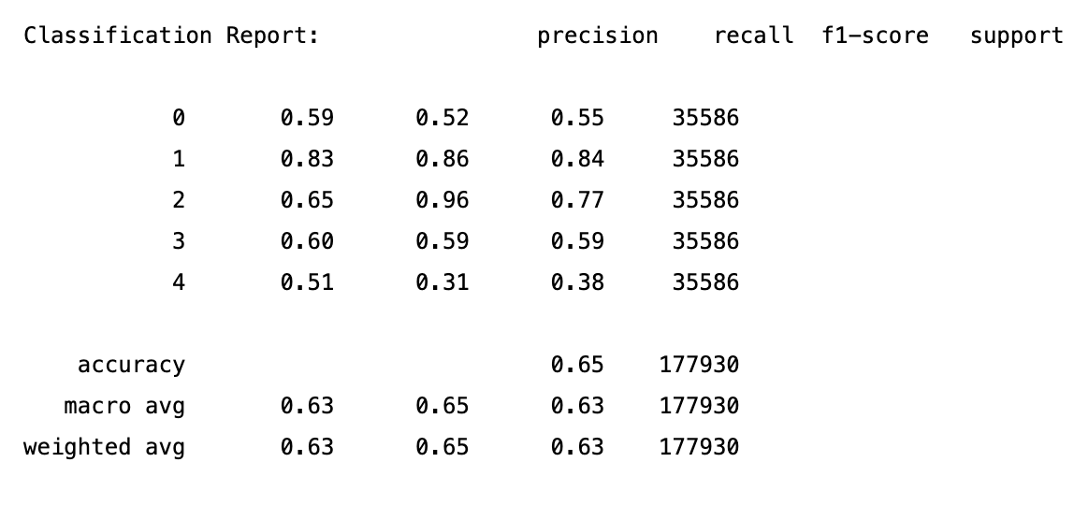
AdaBoost Classifier Results

Slide 27
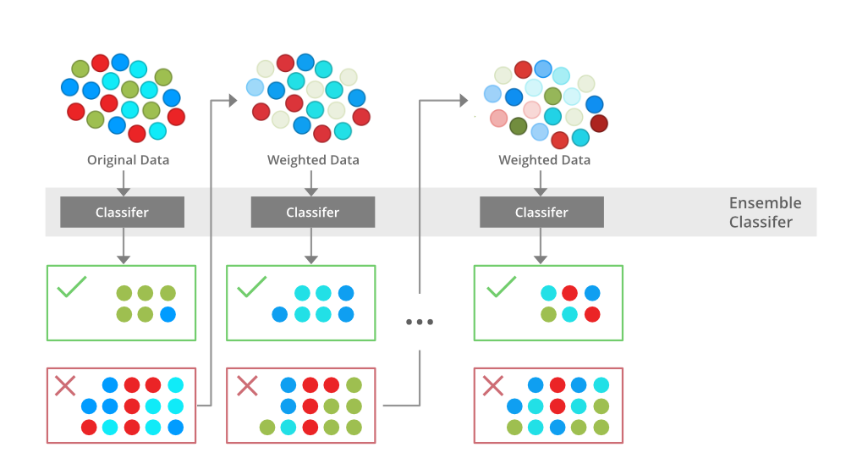
XGBoost Classifier
Decision Tree is a Supervised Machine Learning Algorithm that uses a set of rules to make decisions, similarly to how humans make decisions. It uses the concept of gini index to make a split for decision.

Slide 28
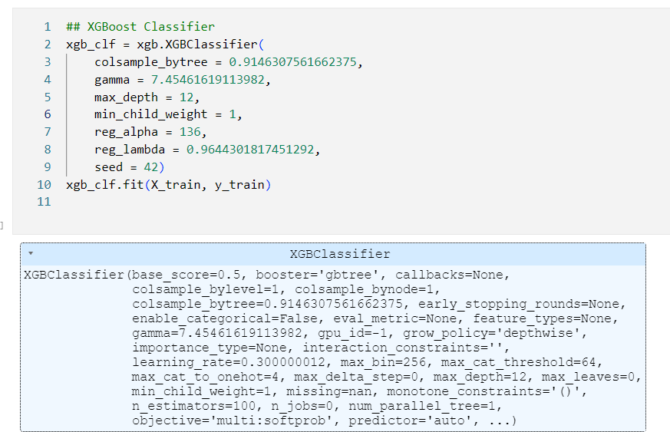
XGBoost Classifier

Slide 29
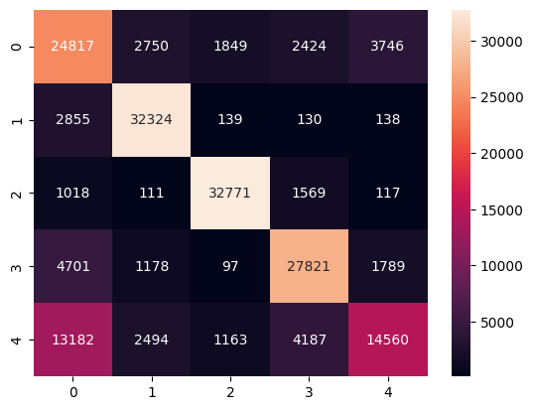
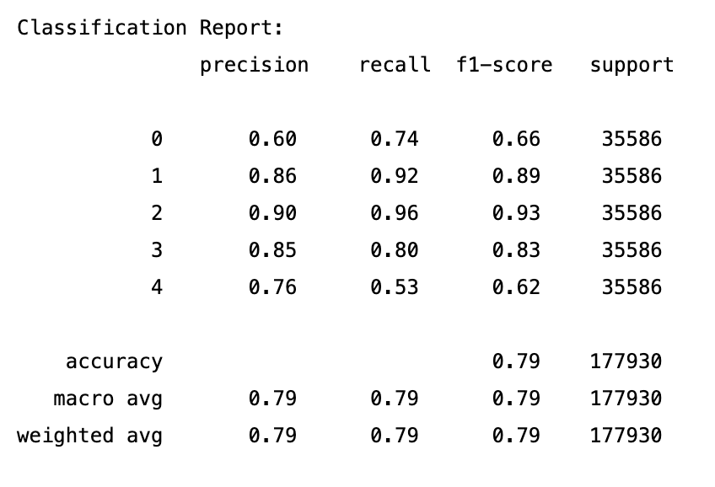
XGBoost Classifier Results

Slide 30
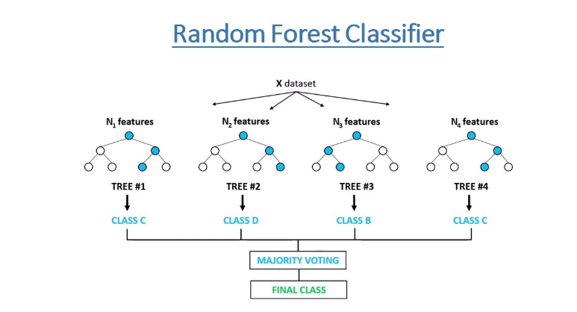
Random Forest Classifier
A random forest is a meta estimator that fits a number of decision tree classifiers on various sub-samples of the dataset and uses averaging to improve the predictive accuracy and control over-fitting

Slide 31
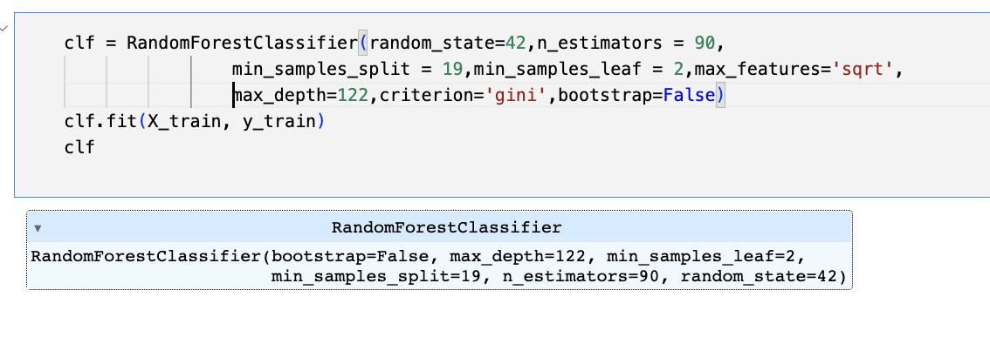
Random Forest Classifier

Slide 32
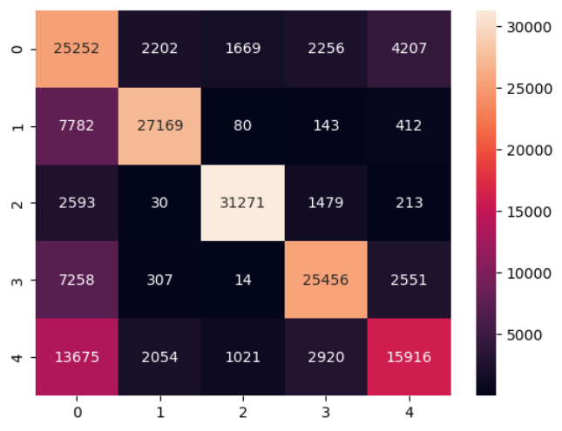
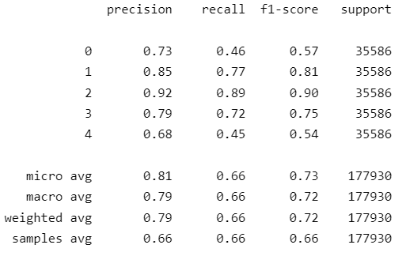
Random Forest Classifier Results

Slide 33
05
Results

Slide 34
Results from different models
Based on 10-fold cross evaluation
Model | Accuracy | Precision | Recall | F1
Decision Tree | 0.601 | 0.885 | 0.601 | 0.695
Deep Learning Classifier | 0.81
AdaBoost Classifier | 0.699 | 0.857 | 0.699 | 0.752
XG Boost Classifier | 0.699 | 0.857 | 0.699 | 0.752
Random Forest | 0.605 | 0.857 | 0.605 | 0.673

Slide 35
06
Future works

Slide 36
Future works
Since the data currently available is restricted to the Philadelphia region, in the future we aim to add data from various other jurisdictions.
Other Classification models like GRU, CNN and other traditional machine learning models could have also been used for the work.

Slide 37
07
Where to look for our work?

Slide 38
Distributions
Github
ris3abh/Sentencing_prediction (github.com)

Slide 39
08
Reference

Slide 40
RESOURCES
[1]. Kaufman, A., Kraft, P., & Sen, M. (2019). Improving Supreme Court Forecasting Using Boosted Decision Trees. Political Analysis, 27(3), 381-387. doi:10.1017/pan.2018.59
[2]. Benjamin, L.; Tom, C. The Supreme Court’s Many Median Justices. Am. Political Sci. Rev. 2012, 106, 847–866. [CrossRef]
[3]. Huang, Y.X.; Dai, W.Z.; Yang, J.; Cai, L.W.; Cheng, S.F.; Huang, R.Z.; Li, Y.F.; Zhou, Z.H. Semi-Supervised Abductive Learning and Its Application to Theft Judicial Sentencing. In Proceedings of the 2020 IEEE International Conference on Data Mining (ICDM), Sorrento, Italy, 17–20 November 2020; pp. 1070–1075.
[4]. Katz, D.M.; Bommarito, M.J., II; Blackman, J. A General Approach for Predicting the Behavior of the Supreme Court of the United States. PLoS ONE 2016, 12, e0174698. [CrossRef]
[5]. Bunn, Derek & Wright, George. (1991). Interaction of Judgemental and Statistical Forecasting Methods: Issues & Analysis. Management Science. 37. 501-518. 10.1287/mnsc.37.5.501.
[6]. Ouyang, L.; Huang, R.; Chen, Y.; Qin, Y. A Sentence Prediction Approach Incorporating Trial Logic Based on Abductive Learning. Appl. Sci. 2022, 12, 7982. https://doi.org/10.3390/app12167982
[7]. https://doi.org/10.48550/arXiv.1807.02478
[8]. Luo, B.F.; Feng, Y.S.; Xu, J.B.; Zhang, X.; Zhao, D.Y. Learning to Predict Charges for Criminal Cases with Legal Basis. In Proceedings of the 2017 Conference on Empirical Methods in Natural Language Processing (EMNLP), Copenhagen, Denmark, 7–11 September 2017; pp. 2727–2736.

Slide 41
Thanks

